Slide 1

Node where Operation is done

Slide 2
Reference
Youtube
Code

Slide 3
Define Node where Operation is done

Slide 4
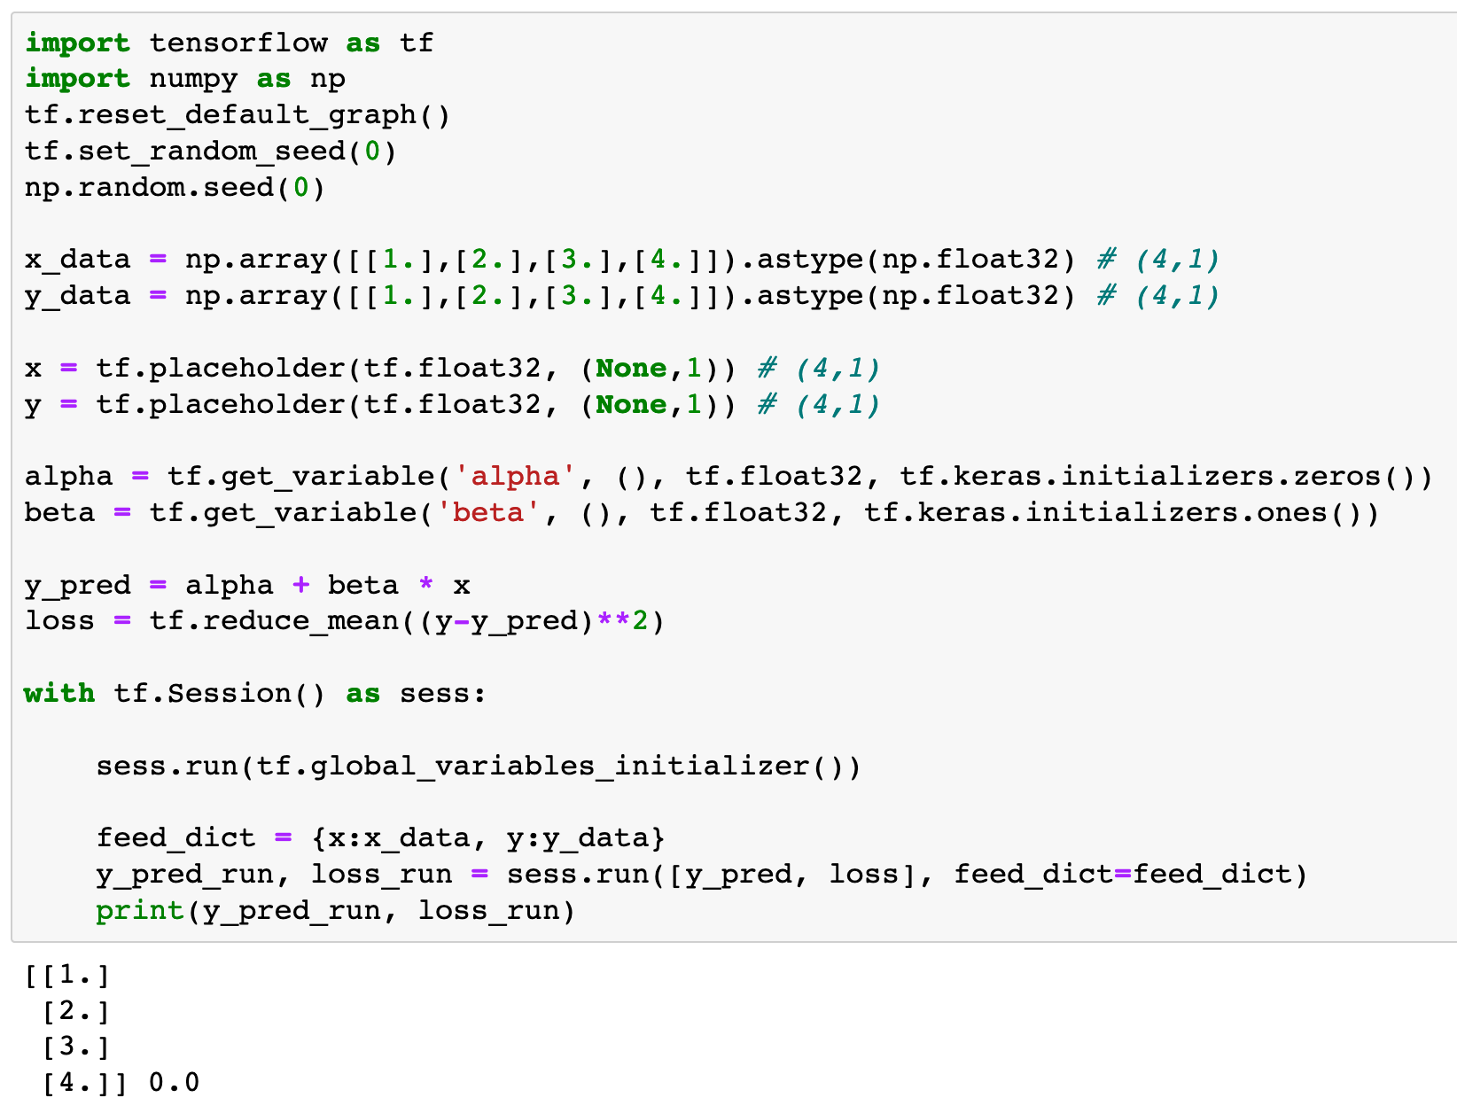

Slide 5
Node where Data is fed

Slide 6
Node with Varying Values

Slide 7
Node where Operation is done

Slide 8
Execute Node where Operation is done

Slide 9
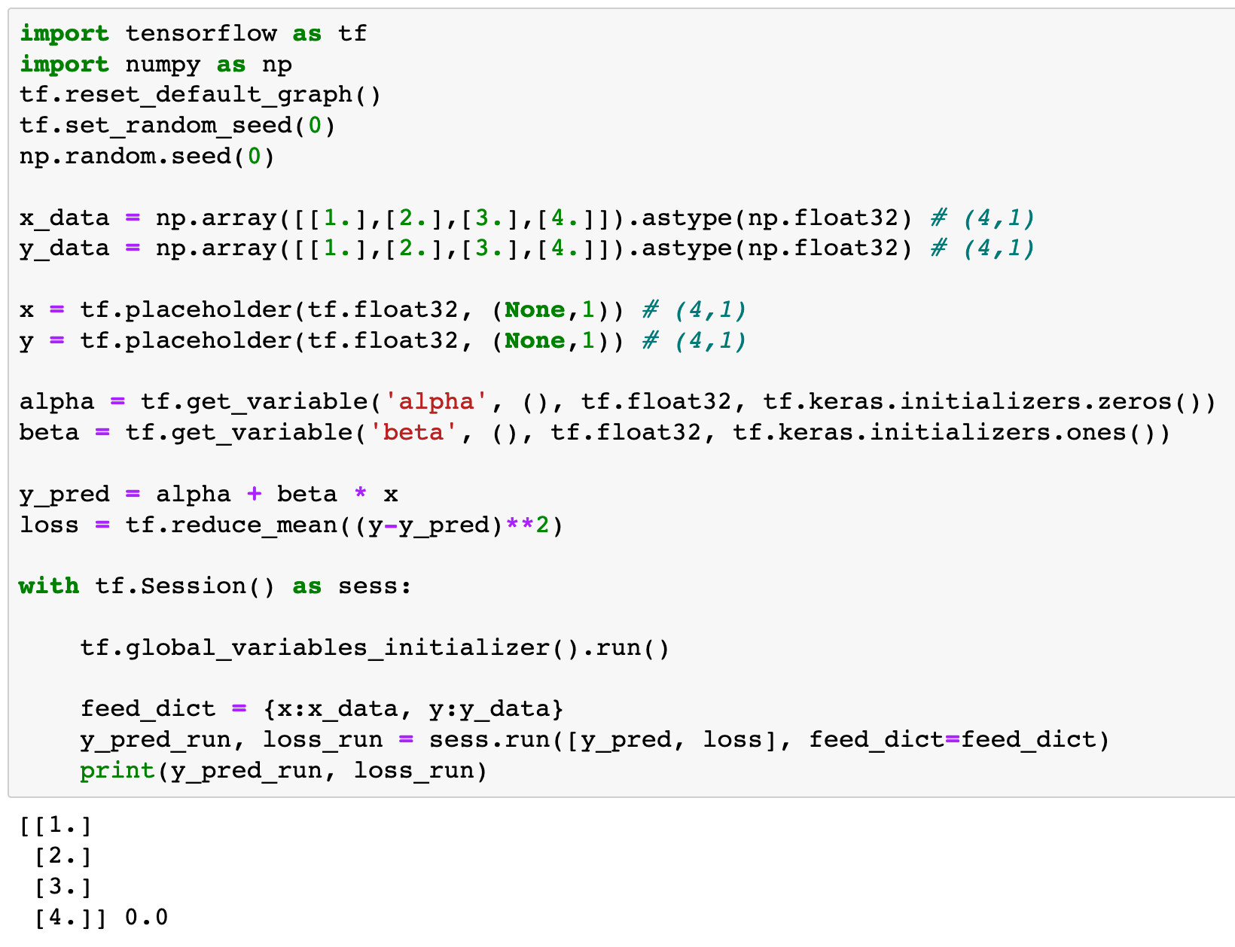
Initialize Node with Varying Values

Slide 10
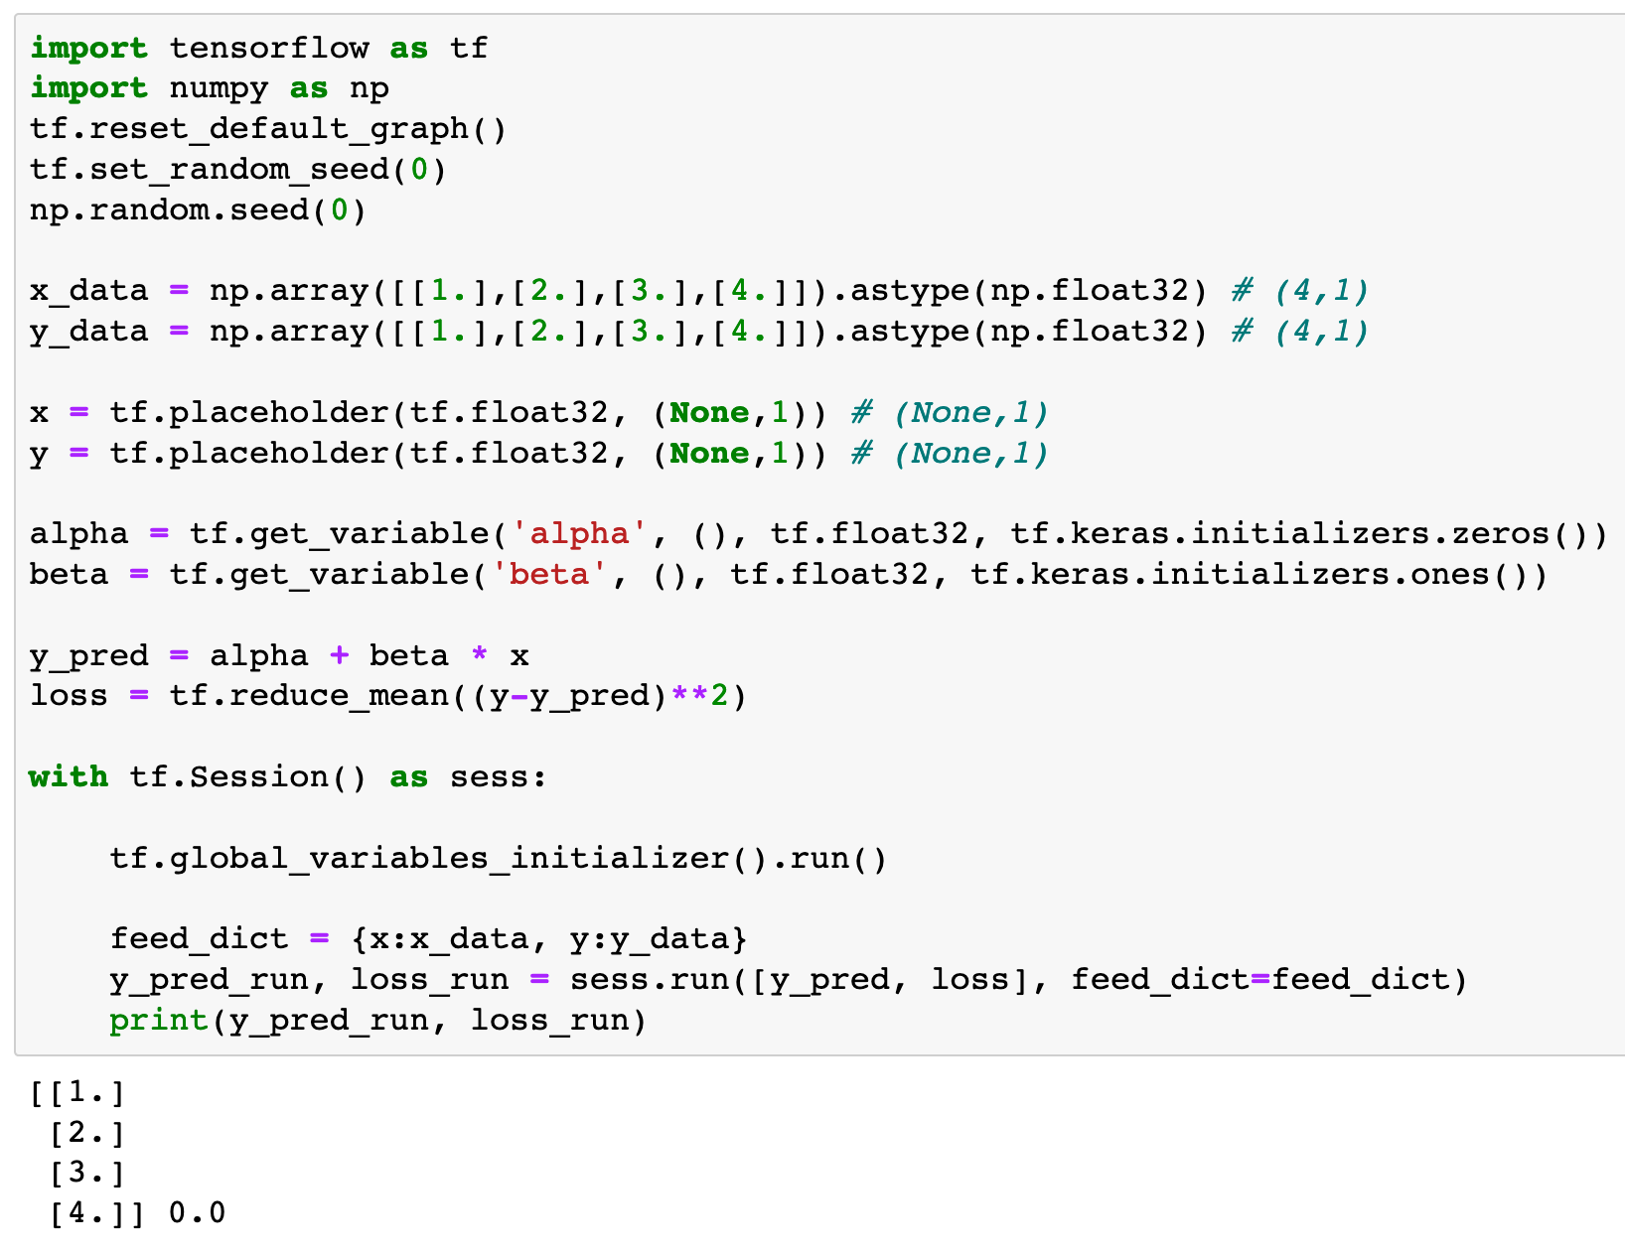
Node where Data is fed

Slide 11
Data to feed
Node where Data is fed

Slide 12
feed_dict keyword

Slide 13
Data to feed in dict Form
feed_dict keyword

Slide 14
Execute Node

Slide 15
Now
Let’s Play with Code

